Slide 1

Computer Networking CCNA 200-301

Slide 2
Course Outline
Module 1 Network Fundamentals
Explain Role and Function of Network Components : Routers, Switches, Firewall, IPs, WLC, AP, Endpoints, Servers
OSI Reference Model and TCP/ IP Model
IPv4 Addressing and Subnetting
IPv6 Addressing and IPv6 address Types
Module 2 Basic Configuration of Router and Lan Switching
Modes of Router
Basic Security of Router (Passwords) and Configuration of IP on Router
Point to Point connectivity of Routers
Configure and Verify Layer2 Discovery Protocols (CDP and LLDP)
Basic Operation of Switch (Collision Domain and Broadcast Domain)
Spanning-tree Protocol (PVST, RSTP), Port states and Port fast
Configure and Verify VLANS and Inter-switch Connectivity (Trunk ports, 802.Iq)
Ether-channel
Cisco Wireless Architecture and AP modes
Configuration of Wireless Lan Controller and AP Using GUI (WPA, WPA2, PSK)

Slide 3
Course Outline
Module 3 IP Routing
Static Routing with IPv4 and IPv6, floating static route and Default route
Configure and Verify Single area OSPF
DR and BDR election. Point to point, Concept of Router-ID
Module 4 IP Services
NAT
Configure and Verify NTP
Describe DNS, SNMP, Syslog, QOS, Function of FTP and TFPF in network
Configuration of DHCP, telnet and SSH
Describe the function of First hop redundancy protocol (HSRP, VRRP, GLBP)

Slide 4
Course Outline
Module 5 Security Fundamentals
Configure and Verify Access control List
Describe VPN Technologies (Site-to-site VPN and Remote access VPN)
Describe Authentication, Authorization and Accounting (AAA)
Configure Port Security, DHCP Snooping and Dynamic ARP Inspection
Module 6 Automation and Programmability
Explain how automation impacts network management
Compare traditional network with controller-based networking
Compare traditional campus device management with Cisco DNA Center enabled device Management.

Slide 5
Module 5 Security Fundamentals
Configure and Verify Access control List
Describe VPN Technologies (Site-to-site VPN and Remote access VPN)
Describe Authentication, Authorization and Accounting (AAA)
Configure Port Security, DHCP Snooping and Dynamic ARP Inspection

Slide 6
ACL
What is ACL?
ACL stands for Access Control List.
It is used in routers to filter traffic based on rules.
ACLs control which packets are allowed or denied through a network interface.

Slide 7
ACL
Why Use ACLs?
To enhance security by controlling traffic.
To permit or deny specific traffic.
To monitor and manage traffic flow.
Used for network security and access control
Restricts access to devices or certain parts of the network
Filters incoming and outgoing traffic
Controls access to specific websites and services
Can block internet access for selected devices
Helps in efficient traffic routing and management

Slide 8
ACL
Types of ACLs
Standard ACL (Simple version)
Extended ACL (More Detailed)

Slide 9
ACL
Types of ACLs
Standard ACL (Simple version)
Filters traffic based only on source IP address.
Only looks at the sender's IP address (source).
It does NOT care about what type of data it is or where it's going.
Standard ACLs: Range from 1 to 99
🧠 Think of it like:
If this person (IP address) is talking, allow or block them.
Example:
access-list 10 deny 192.168.1.5
This says:❌ Block anything that comes from IP 192.168.1.5

Slide 10
ACL
Types of ACLs
Extended ACL (More Detailed)
Filters Traffic base on source & destination IP, Protocol, port Numbers, etc.
Looks at who is sending, who is receiving, and what type of data it is (like web, email, FTP).
Gives you more control.
Extended ACLs: Range from 100 to 199.
🧠 Think of it like:
If this person (source IP) is talking to that person (destination IP) using this app (like HTTP), allow or block.
Example:
access-list 101 deny tcp 192.168.1.5 any eq 80
This says:❌ Block HTTP (web) traffic coming from 192.168.1.5

Slide 11
ACL
Main Difference:
Feature | Standard ACL | Extended ACL
Checks source only | ✅ Yes | ✅ Yes
Checks destination | ❌ No | ✅ Yes
Checks app/port | ❌ No | ✅ Yes (like HTTP/FTP)
More control? | ❌ Basic | ✅ Detailed
Range | Range from 1 to 99 | Range from 100 to 199

Slide 12
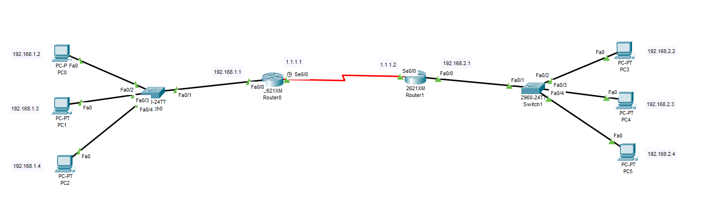
ACL
Practical of Standard ACL:
Facebook
R1
R2
YouTube
Any

Slide 13
ACL
Practical of Standard ACL:
✅ You want to completely block the computer with IP:192.168.1.2 from accessing anything beyond R1, including R2 or the internet.
Since the traffic from 192.168.1.2 goes from R1 → R2 via interface s0/0,
you will apply a Standard ACL on R1, on the s0/0 interface outbound.
Basic configuration
Routing Protocol
Apply ACL

Slide 14
ACL
Practical of Standard ACL:
R1> enable
R1# configure terminal
R1(config)# interface fa0/0
R1(config-if)# ip address 192.168.1.1 255.255.255.0
R1(config-if)# no shutdown
R1(config-if)# exit
R1(config)# interface s0/0
R1(config-if)# ip address 1.1.1.1 255.0.0.0
R1(config-if)# no shutdown
R1(config-if)# exit
R1(config)# router rip
R1(config-router)# network 192.168.1.0
R1(config-router)# network 1.0.0.0
R1(config-router)# exit
R1(config)# access-list 10 deny 192.168.1.2
R1(config)# access-list 10 permit any
R1(config)# interface s0/0
R1(config-if)# ip access-group 10 out
R1(config-if)# exit
R1(config)# exit
R1#
✅ Explanation:
access-list 10 deny 192.168.1.2 → blocks that specific PC
access-list 10 permit any → allows all other traffic
ip access-group 10 out → applies the ACL when traffic is going out of R1 towards R2
✅ How to remove ACL:
R1> enable
R1# configure terminal
R1(config)# no access-list 10 # Removes ACL 10 entirely
R1(config)# interface s0/0
R1(config-if)# no ip access-group 10 out # Removes the ACL from the interface
R1(config-if)# exit
R1(config)# exit
R1#

Slide 15
ACL
Practical of Extended ACL:
✅ You want to completely block the computer with IP:192.168.1.2 from accessing computer with IP:192.168.2.2 Connected to R2
Standard ACLs can only filter by source IP. To block traffic between specific source and destination IPs, use Extended ACLs.
Since the traffic from 192.168.1.2 goes from R1 → R2 via interface s0/0,
you will apply Extended ACL on R1, on the s0/0 interface outbound.
So here we will apply Extended ACL
Basic configuration
Routing Protocol
Apply ACL

Slide 16
ACL
Practical of Extended ACL:
R1> enable
R1# configure terminal
R1(config)# interface fa0/0
R1(config-if)# ip address 192.168.1.1 255.255.255.0
R1(config-if)# no shutdown
R1(config-if)# exit
R1(config)# interface s0/0
R1(config-if)# ip address 1.1.1.1 255.0.0.0
R1(config-if)# no shutdown
R1(config-if)# exit
R1(config)# router rip
R1(config-router)# network 192.168.1.0
R1(config-router)# network 1.0.0.0
R1(config-router)# exit
R1(config)# access-list 100 deny ip host 192.168.1.2 host 192.168.2.2
R1(config)# access-list 100 permit ip any any
R1(config)# interface s0/0
R1(config-if)# ip access-group 100 out
R1(config-if)# exit
R1(config)# exit
R1#
✅ How to remove ACL:
R1> enable
R1# configure terminal
R1(config)# no access-list 100
R1(config)# interface s0/0
R1(config-if)# no ip access-group 100 out
R1(config-if)# exit

Slide 17
ACL
Practical of Extended ACL:
✅ To block ICMP (ping) from R2 to R1:
✅ How to remove ACL:
R1> enable
R1# configure terminal
R1(config)# interface s0/0
R1(config-if)# no ip access-group 100 in
R1(config-if)# exit
R1(config)# no access-list 100
R1(config)# exit
R1# write memory
R1> enable
R1# configure terminal
R1(config)# interface fa0/0
R1(config-if)# ip address 192.168.1.1 255.255.255.0
R1(config-if)# no shutdown
R1(config-if)# exit
R1(config)# interface s0/0
R1(config-if)# ip address 1.1.1.1 255.0.0.0
R1(config-if)# no shutdown
R1(config-if)# exit
R1(config)# router rip
R1(config-router)# network 192.168.1.0
R1(config-router)# network 1.0.0.0
R1(config-router)# exit
R1(config)# access-list 100 deny icmp 192.168.2.0 0.0.0.255 192.168.1.0 0.0.0.255 echo
R1(config)# access-list 100 permit ip any any
R1(config)# interface s0/0
R1(config-if)# ip access-group 100 in
R1(config-if)# exit
R1(config)# exit

Slide 18
Describe VPN Technologies (Site-to-site VPN and Remote access VPN)
🔐 What is VPN?
VPN (Virtual Private Network) allows secure communication between networks or devices over shared or public networks, often using encryption.
🌍 1. Site-to-Site VPN
Connects two or more networks (sites) securely.
Commonly used between head office and branch offices.
Routers/firewalls on both ends create and manage the VPN tunnel.
Traffic is automatically encrypted between sites. Users on each side don’t need to do anything — it’s transparent.
Mostly used over the internet, but can also run on private WAN links.
Example: Computers in branch office can access servers at head office as if they were on the same LAN.
👤 2. Remote Access VPN
Connects a single user to a company’s network.
Requires a VPN client on the user’s device (laptop, phone).
The user must manually connect and authenticate.
Example: An employee connects from home to access files on the office network.

Slide 19
Describe VPN Technologies (Site-to-site VPN and Remote access VPN)
👤 3. MP-VPN (Multi-Protocol Virtual Private Network)
MP-VPN allows multiple types of traffic to pass through a single VPN tunnel.
It is protocol-independent, meaning it can carry both IPv4 and IPv6 traffic.
Supports Multiple Protocols: Allows different traffic types (like voice, video, data) over the same network.
Used for Multi-Site Connections: Connects various sites with different types of traffic across one VPN.
Example:
A company has several offices worldwide:
One uses VoIP (voice).
Another handles video conferencing.
Another uses data traffic.
MP-VPN allows all these different traffic types to be securely transmitted over the same VPN tunnel.
Why Use MP-VPN?
Service Providers: Efficiently manage multiple customers' diverse traffic over a single infrastructure.
Large Organizations: Handle various traffic types (data, voice, video) securely across many locations.

Slide 20
Describe VPN Technologies (Site-to-site VPN and Remote access VPN)
Summary
Both VPN types use the internet but serve different purposes.
Site-to-Site VPN is for connecting locations.
Remote Access VPN is for individual users.
Both ensure secure data transfer.
Protocol | Description | Use Case
IPSec | Encrypts IP packets, commonly used in Site-to-Site VPNs. | Routers/firewalls between offices.
L2TP/IPSec | Layer 2 Tunneling Protocol + IPSec encryption. | Remote Access VPN.
OpenVPN | Open-source, uses SSL/TLS for encryption. | Remote Access VPN (cross-platform).
SSL VPN | Uses Secure Sockets Layer (SSL), works via browser or VPN client. | Remote Access without installing much.
IKEv2/IPSec | Fast and stable; good for mobile connections (supports switching networks). | Smartphones, laptops on the go.
WireGuard | Newer, lightweight, and fast with strong security. | Both Site-to-Site and Remote Access.

Slide 21
Describe Authentication, Authorization and Accounting (AAA)
AAA – Authentication, Authorization, and Accounting
Authentication
Confirms who you are.
Example: Entering a username and password to log in
Authorization
Controls what you can do after authentication.
Example: A user can access files but can’t install software.
Accounting
Keeps a log of what you do.
Example: Tracks login times, commands entered, data usage, etc.
AAA is commonly used in network security systems like firewalls, VPNs, and routers, often with protocols like RADIUS or TACACS+.
You configure AAA on routers, switches, or firewalls to control access.

Slide 22
Describe Authentication, Authorization and Accounting (AAA)
Comparison between normal login (without AAA) and login with AAA.
🔑 Without AAA (Basic Passwords)
Router(config)# enable secret cisco
Router(config)# line vty 0 4
Router(config-line)# password mypass
Router(config-line)# login
✅ This means anyone who connects to the router and knows the password can get in.
🚫 You can't control who is logging in, what they can do, or log their activity.
🔐 With AAA (Authentication, Authorization, Accounting)
You enable AAA.
You create local users with usernames/passwords.
Router will now use that user info for login (instead of just a password).

Slide 23
Describe Authentication, Authorization and Accounting (AAA)
🔄 Now when someone connects via SSH or Telnet:
Router says: “Enter username and password.”
It checks locally (because we told it aaa authentication login default local)
If it matches → login successful.
✅ When AAA is configured locally on the router:
User tries to log in (console, SSH, or telnet).
Router asks for username and password.
Router checks the credentials against the local AAA database.
If correct → ✅ Login successful
If incorrect → ❌ Access denied

Slide 24
Configure Port Security, DHCP Snooping and Dynamic ARP Inspection
Port Security
Port security limits the number of devices that can connect to a switch port based on their MAC addresses. If an unauthorized device tries to connect, the port is shut down to prevent access.
Shutdown the port,
Restrict access,
Protect the port by dropping unauthorized traffic.
when the port shuts down, it needs to be manually turned on.
It can be automatically turned on by configuring the errdisable recovery feature.
Cisco 2960 switch: Can bind 1 to 132 MAC addresses to a single port.
High-level switches: Can bind up to 6,000 MAC addresses to a single port.

Slide 25
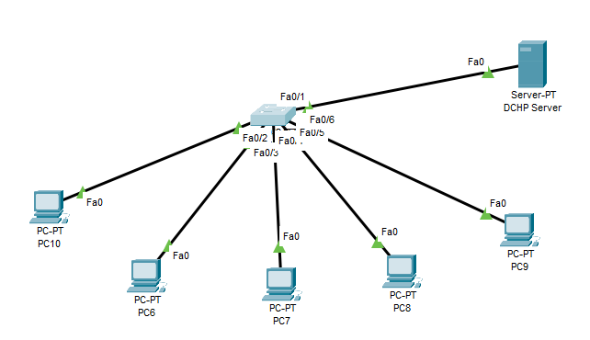
Configure Port Security, DHCP Snooping and Dynamic ARP Inspection
Port Security Practicle

Slide 26
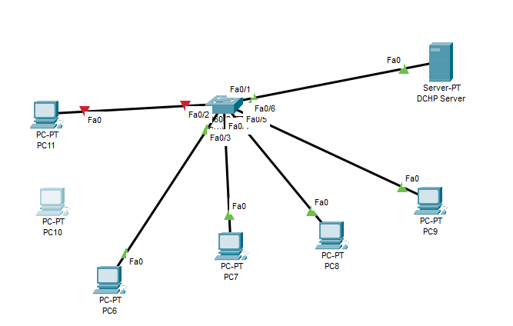
Configure Port Security, DHCP Snooping and Dynamic ARP Inspection
Port Security Practicle:
Switch> enable
Switch# configure terminal
Switch(config)# interface FastEthernet0/2
Switch(config-if)# switchport mode access
Switch(config-if)# switchport port-security
Switch(config-if)# switchport port-security maximum ?
<1-132>
Switch(config-if)# switchport port-security maximum 1
Switch(config-if)# switchport port-security mac-address sticky
Switch(config-if)#
switch# show port-security
switch# show port-security interface fa0/2 Result
How to remove it:
Switch> enable
Switch# configure terminal
Switch(config)# interface FastEthernet0/2
Switch(config-if)# no switchport port-security
Switch(config-if)# no switchport port-security mac-address sticky
New System

Slide 27
Configure Port Security, DHCP Snooping and Dynamic ARP Inspection
DHCP Spoofing:
An attack where a rogue DHCP server provides false IP configurations to clients.
Can lead to man-in-the-middle attacks, data interception, or network disruption.
DHCP Snooping
Protects the network by allowing only trusted DHCP servers to assign IP addresses.
Tracks trusted and untrusted ports, blocking DHCP responses from unauthorized servers.
DHCP Snooping is the solution to DHCP Spoofing.

Slide 28
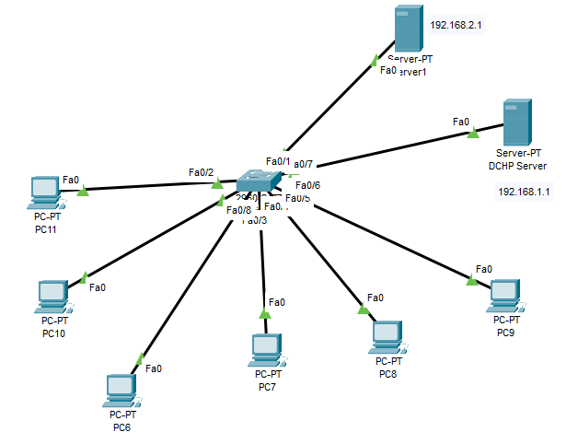
Configure Port Security, DHCP Snooping and Dynamic ARP Inspection
Practical :
Trusted DCHP Server
Attacker DHCP Server

Slide 29
Configure Port Security, DHCP Snooping and Dynamic ARP Inspection
Practical :
Legitimate DHCP server (192.168.1.1) connected to fa0/1 assigns IPs to clients.
Rogue DHCP server (192.168.2.1) connected to fa0/7 sends false IP offers.
Clients may get incorrect settings (wrong gateway/DNS).
Impact: Possible network disruption or man-in-the-middle attacks.
Solution: Use DHCP Snooping to block the rogue server.
Attacker DHCP Server
Trusted DCHP Server

Slide 30
Configure Port Security, DHCP Snooping and Dynamic ARP Inspection
DHCP Snooping Practical :
Attacker DHCP Server
This will make all ports untrust for DHCP
Switch> enable
Switch# configure terminal
Switch(config)# ip dhcp snooping
Switch(config)# ip dhcp snooping vlan 1
Switch(config)# no ip dhcp snooping information option
Switch(config)# interface FastEthernet0/1
Switch(config-if)# ip dhcp snooping trust
Switch# show ip dhcp snooping
Switch#show ip dhcp snooping binding
Remove or undo DHCP Snooping
Switch> enable
Switch# configure terminal
Switch(config)# no ip dhcp snooping
Switch(config)# no ip dhcp snooping vlan 1
Switch(config)# interface FastEthernet0/1
Switch(config-if)# no ip dhcp snooping trust
Trusted DCHP Server
Result

Slide 31
Configure Port Security, DHCP Snooping and Dynamic ARP Inspection
Dynamic ARP Inspection :
What is ARP (Address Resolution Protocol
ARP (Address Resolution Protocol) is a protocol used in networking to find the MAC address of a device when you only know its IP address.
ARP is handled by end devices (computers, laptops, servers, routers, etc.) that need to communicate over a network.
When your PC wants to send data to another PC in the same network, it uses ARP to find the other device’s MAC address.
A switch does not run ARP itself.
It only uses MAC addresses to forward frames.
The switch simply forwards the ARP request broadcast to all devices in the same network, and the correct device replies back.
End device (like PC/Router) = Runs ARP protocol
Switch = Just forwards ARP packets, doesn’t create them

Slide 32
Configure Port Security, DHCP Snooping and Dynamic ARP Inspection
Dynamic ARP Inspection :
🔹 Problem First: ARP Spoofing/Poisoning
Normally, ARP has no security , any device can reply to an ARP request, even if it’s lying.
An attacker can send fake ARP replies, saying: “Hey, the gateway’s IP belongs to my MAC!”
Then all traffic goes through the attacker → Man-in-the-Middle (MITM) attack.
🔹 Solution: Dynamic ARP Inspection (DAI)
DAI is a security feature on switches that checks ARP packets to make sure they are valid.
It looks at a trusted database (like the DHCP snooping table) to confirm: “Does this IP really belong to this MAC?”
Dynamic ARP Inspection = A security guard in the switch that stops fake ARP messages and protects against ARP spoofing.

Slide 33
Configure Port Security, DHCP Snooping and Dynamic ARP Inspection
Dynamic ARP Inspection :
Example :
🖥️ Normal case (without attacker)
Gateway (Router) has IP 192.168.1.1 and its own MAC (let’s say AA:BB:CC).
PC1 asks: “Who has 192.168.1.1?”
Router replies: “192.168.1.1 is at AA:BB:CC.”
Now PC1 knows the real MAC of the gateway and can send traffic correctly.
🚨 Attack case (ARP spoofing)
Attacker PC2 lies and sends a fake ARP reply:“192.168.1.1 (Gateway) is at my MAC E5:F6:G7.”
PC1 believes it (because normal ARP has no security).
Result: All traffic from PC1 to the internet goes to attacker PC2 instead of the real router.
🛡️ With DAI enabled on switch
Switch keeps a “truth table” (from DHCP Snooping) → it knows which IP belongs to which MAC.
Example:
192.168.1.1 → AA:BB:CC (gateway)
192.168.1.10 → A1:B2:C3 (PC1)
When Attacker PC2 says: “192.168.1.1 is at E5:F6:G7”
Switch checks the table → mismatch (gateway IP should not map to that MAC).
Switch drops the fake ARP reply. ✅

Slide 34
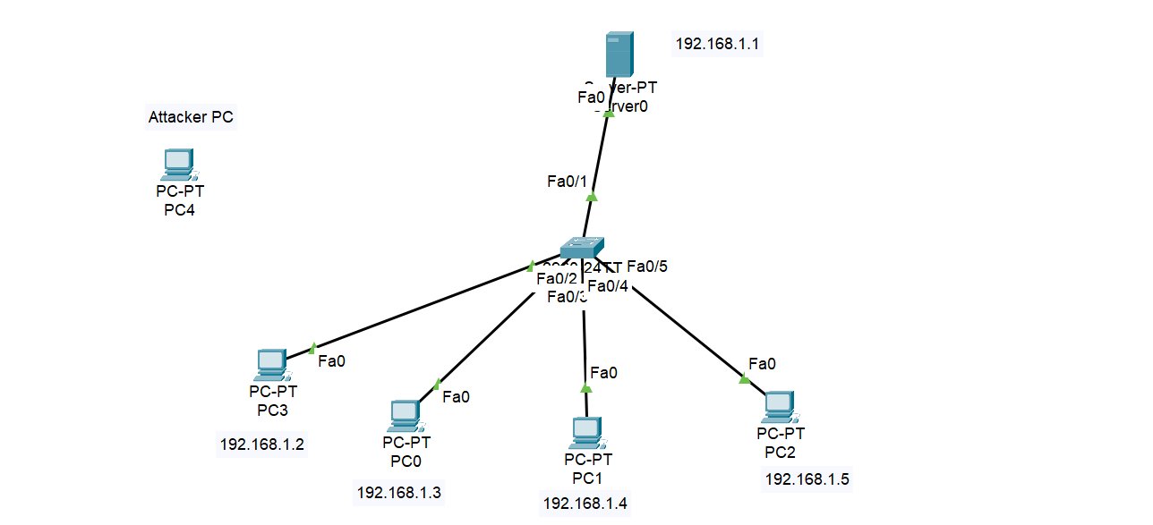
Configure Port Security, DHCP Snooping and Dynamic ARP Inspection
Dynamic ARP Inspection :

Slide 35
Configure Port Security, DHCP Snooping and Dynamic ARP Inspection
Dynamic ARP Inspection Practical :
switch> enable
switch# configure terminal
switch(config)# ip dhcp snooping
switch(config)# ip dhcp snooping vlan 1
switch(config)# no ip dhcp snooping information option
switch(config)# interface FastEthernet0/1
switch(config-if)# ip dhcp snooping trust
switch(config-if)# exit
switch(config)# ip arp inspection vlan 1
switch# show ip dhcp snooping binding Result
Undo the DHCP Snooping and ARP Inspection
switch> enable
switch# configure terminal
switch(config)# no ip dhcp snooping
switch(config)# no ip dhcp snooping vlan 1
switch(config)# no ip dhcp snooping information option
switch(config)# interface FastEthernet0/1
switch(config-if)# no ip dhcp snooping trust
switch(config-if)# exit
switch(config)# no ip arp inspection vlan 1
On Attacker computer CMD ,
arp -a (Show arp table)
arp -d (Delete arp entries)

Slide 36
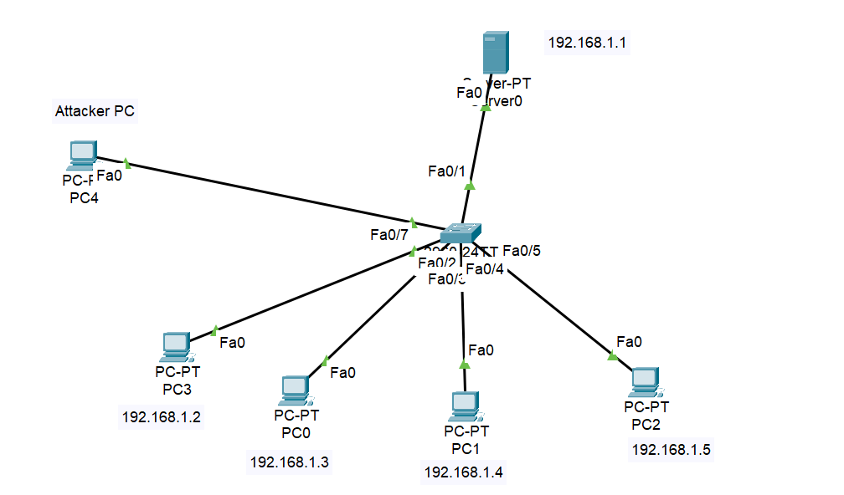
Configure Port Security, DHCP Snooping and Dynamic ARP Inspection
Dynamic ARP Inspection :
Assign IP of the same network to this attacker computer. Or assign the gateway IP to this attacker computer and connect it to the switch

Slide 37
Configure Port Security, DHCP Snooping and Dynamic ARP Inspection
Dynamic ARP Inspection Practical :
The attacker machine ARP replies will be blocked by the Dynamic ARP Inspection(DAI)
On Attacker computer CMD ,
arp -a (Show arp table)
arp -d (Delete arp entries)
And then check the connectivity

